Slide 1
OPERATION ANALYTICS AND INVESTIGATING METRIC SPIKE
By- Rahul M Ramchandani

Slide 2
About the Project
Operational Analytics is a crucial process that involves analyzing a company's end-to-end operations. This analysis helps identify areas for improvement within the company. As a Data Analyst, you'll work closely with various teams, such as operations, support, and marketing, helping them derive valuable insights from the data they collect.
One of the key aspects of Operational Analytics is investigating metric spikes. This involves understanding and explaining sudden changes in key metrics, such as a dip in daily user engagement or a drop in sales. As a Data Analyst, you'll need to answer these questions daily, making it crucial to understand how to investigate these metric spikes.

Slide 3
About the Project
SQL TASKS :-
Case Study 1: Job Data Analysis
Jobs Reviewed Over Time
Throughput Analysis
Language Share Analysis
Duplicate Rows Detection

Slide 4
About the Project
Case Study 2: Investigating Metric Spike
Weekly User Engagement
User Growth Analysis
Weekly Retention Analysis
Weekly Engagement Per Device
Email Engagement Analysis
Software used :- MySQL Workbench 8.0 CE

Slide 5
Case Study 1: Job Data Analysis
A. Jobs Reviewed Over Time
Objective: Calculate the number of jobs reviewed per hour for each day in November 2020.
Task: Write an SQL query to calculate the number of jobs reviewed per hour for each day in November 2020.
Query:-
select count(distinct job_id)/(30*24) as no_of_jobs_reviewed
from job_data;

Slide 6

A. Jobs Reviewed Over Time
Output :-

Slide 7
Case Study 1: Job Data Analysis
B. Throughput Analysis
Objective: Calculate the 7-day rolling average of throughput (number of events per second).
Task: Write an SQL query to calculate the 7-day rolling average of throughput. Additionally, explain whether you prefer using the daily metric or the 7-day rolling average for throughput, and why.
Query:-
select ds, count(distinct job_id) as jobs_reviewed, avg(count(distinct job_id)) OVER (ORDER BY ds ROWS BETWEEN 6 PRECEDING AND CURRENT ROW) as throughput_7_rolling_avg from job_data group by ds order by ds;

Slide 8
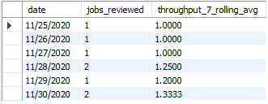
B. Throughput Analysis
Output :-

Slide 9
Case Study 1: Job Data Analysis
C. Language Share Analysis Objective: Calculate the percentage share of each language in the last 30 days.
Task: Write an SQL query to calculate the percentage share of each language over the last 30 days. Query:-
SELECT language, (COUNT(language) * 100.0 / SUM(COUNT(*)) OVER ()) AS percentage_share
from job_data
group by language;

Slide 10
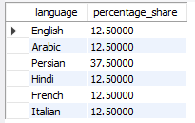
C. Language Share Analysis
Output :-

Slide 11
Case Study 1: Job Data Analysis
D. Duplicate Rows Detection Objective: Identify duplicate rows in the data.
Task: Write an SQL query to display duplicate rows from the job_data table. Query:-
SELECT * FROM ( SELECT *, ROW_NUMBER() OVER (PARTITION BY job_id) AS no_of_rows FROM job_data) a WHERE no_of_rows > 1;

Slide 12

D. Duplicate Rows Detection Output :-

Slide 13
Case Study 2: Investigating Metric Spike
Weekly User Engagement
Objective: Measure the activeness of users on a weekly basis.
Task: Write an SQL query to calculate the weekly user engagement.
Query:-
select extract(week from occured_at) as week_numbers, count(distinct user_id) as active_users from events where event_type='engagement’ group by week_numbersorder by week_numbers;

Slide 14
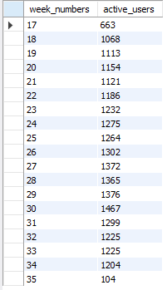
A. Weekly User Engagement
Output :-

Slide 15
Case Study 2: Investigating Metric Spike
B. User Growth Analysis
Objective: Analyze the growth of users over time for a product
Task: Write an SQL query to calculate the user growth for the product.
Query:-
SELECT YEAR(u.created_at) AS year,
MONTH(u.created_at) AS month,
COUNT(DISTINCT u.user_id) AS new_users
FROM users u
GROUP BY YEAR(u.created_at), MONTH(u.created_at)
ORDER BY YEAR(u.created_at), MONTH(u.created_at);

Slide 16
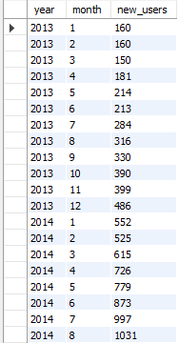
B. User Growth Analysis
Output :-

Slide 17
Case Study 2: Investigating Metric Spike
C. Weekly Retention Analysis:
Objective: Analyze the retention of users on a weekly basis after signing up for a product.
Task: Write an SQL query to calculate the weekly retention of users based on their sign-up cohort. Query:-

Slide 18
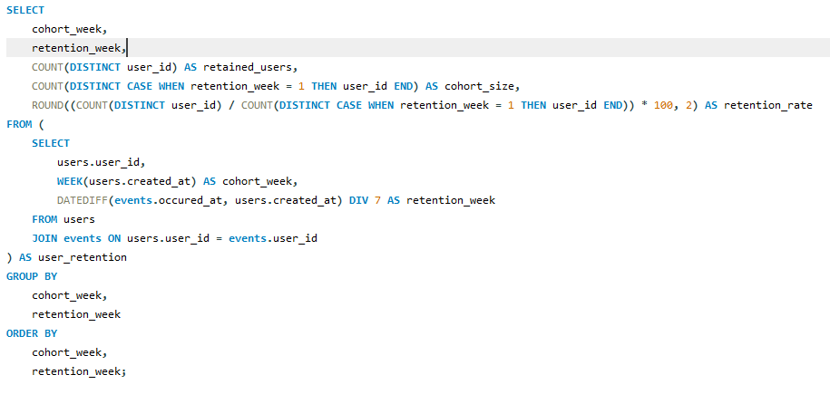
Query:-

Slide 19
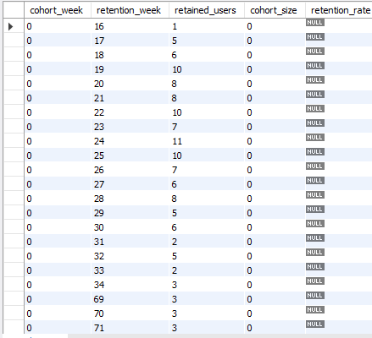
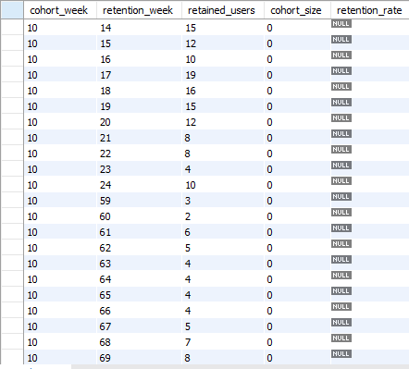
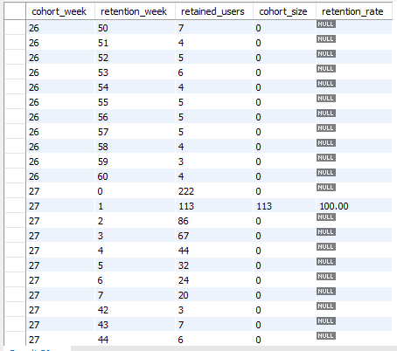
C. Weekly Retention Analysis: Output :- output was huge as there were 1000 rows. Attaching some of output screenshots-

Slide 20
Case Study 2: Investigating Metric Spike
D. Weekly Engagement Per Device: Objective: Measure the activeness of users on a weekly basis per device. Task: Write an SQL query to calculate the weekly engagement per device. Query:- SELECT YEAR(occured_at) AS year, WEEK(occured_at) AS week_number, device, COUNT(*) AS engagement_count FROM events GROUP BY YEAR(occured_at),WEEK(occured_at),device ORDER BY year, week_number, device;

Slide 21
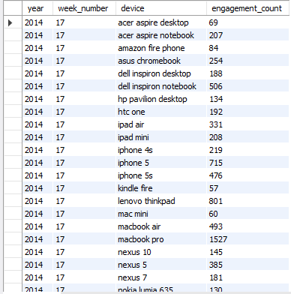
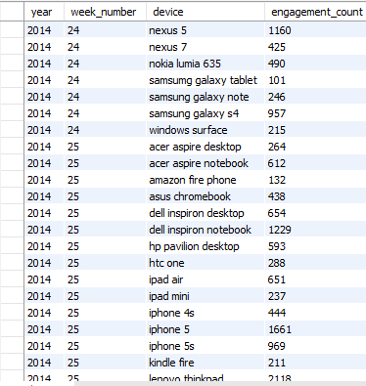
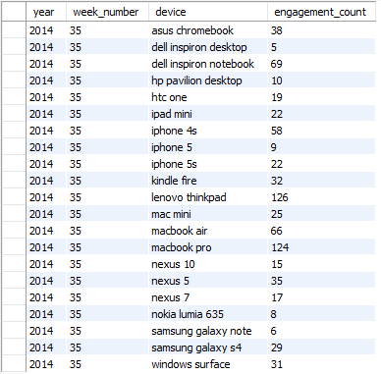
D. Weekly Engagement Per Device: Output :- output was huge. Attaching some of output screenshots-

Slide 22
Case Study 2: Investigating Metric Spike
E. Email Engagement Analysis Objective: Analyze how users are engaging with the email service. Task: Write an SQL query to calculate the email engagement metrics. Query:- SELECT action, COUNT(*) AS total_actions, COUNT(DISTINCT user_id) AS unique_users, COUNT(*) / COUNT(DISTINCT user_id) AS average_actions_per_user FROM email_events GROUP BY action;

Slide 23

E. Email Engagement Analysis
Output :-

